Slide 1
Using NAIP Aerials to Assess Impervious Surface Area
Presented by INCOG
August 12, 2022
Nienhuis Park Center, Broken Arrow

Slide 2
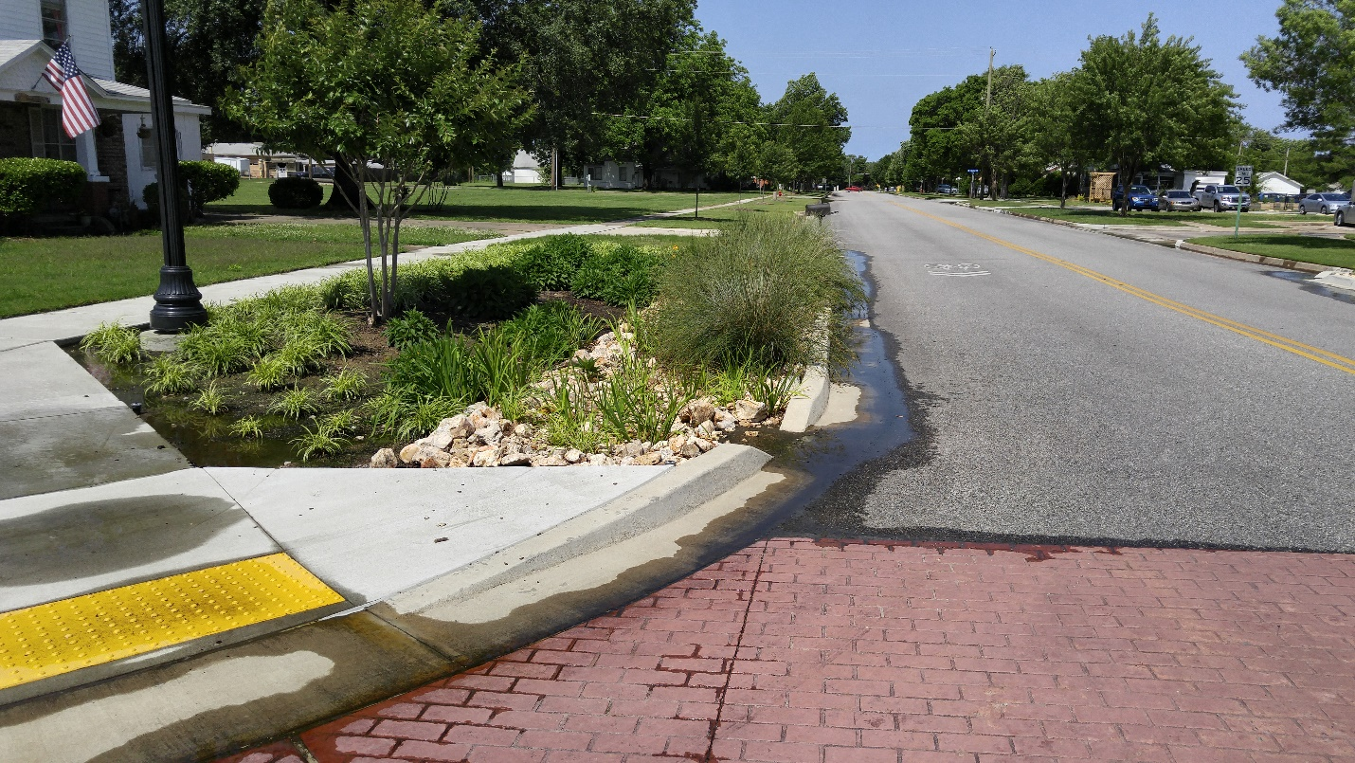
Impervious Study Methodology Development
By: Ty Simmons, Principal GIS Analyst
Vernon Seaman, Water Quality Specialist
FY-18 604(b) Project 2, Output 203

Slide 3
Project Summary
Accurately estimating impervious surface area for large areas can be time-consuming and tedious
Use of National Agriculture Imagery Program (NAIP) aerials and Arc GIS Desktop software
Knowing the amount of impervious surface area is useful in determining runoff from rainfall and snow melt, stream loading, peaking potential, stormwater collection system sizing, identifying problem areas, and percent of impervious area in a watershed
Issues and difficulties encountered and how to work around them
Tree canopy coverage was also determined using this same image classification

Slide 4
Broken Arrow, OK
Fourth largest city in Oklahoma
2020 census population of 113,540
Land area in Tulsa and Wagoner Counties
Land area of 61.63 square miles
Land use practices range from agricultural to heavy industrial

Slide 5
Defining the Project
This information is more useful when combined with watershed and municipal boundaries, topo contours, building footprints, waterbodies, zoning, subdivisions, and stormwater collection system maps.
INCOG’s work employed ESRI’s ArcGIS Desktop software utilizing the Spatial Analyst extension, along with NAIP aerials.
Inputs for the EPA National Stormwater Calculator include a percent pervious and impervious surface area and type of pervious cover.
Tree canopy was easy to assess with this process and aids in selecting additional areas that could benefit from future plantings.

Slide 6
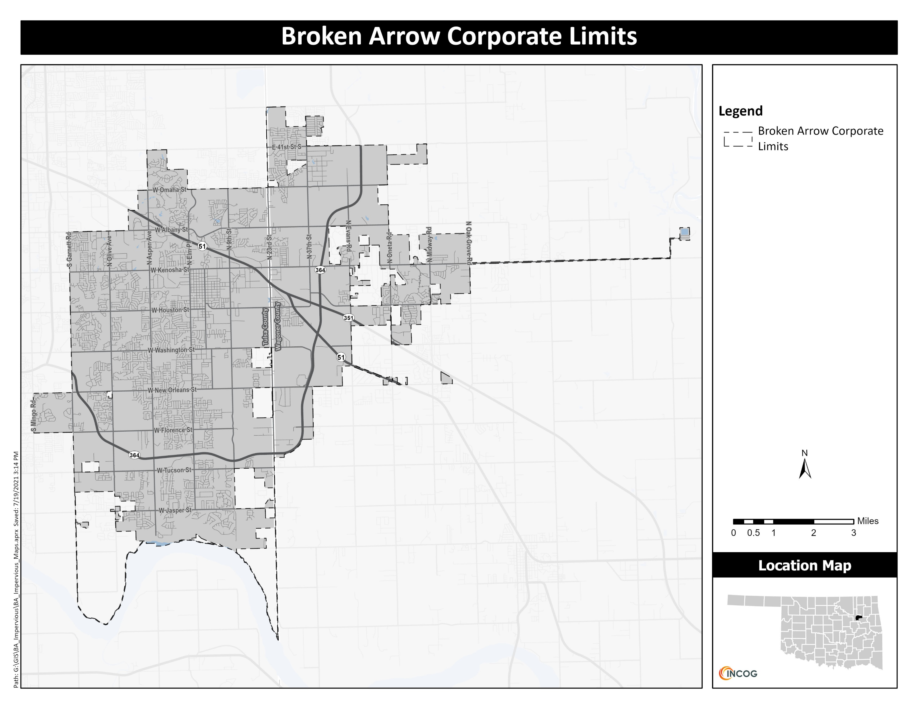

Slide 7
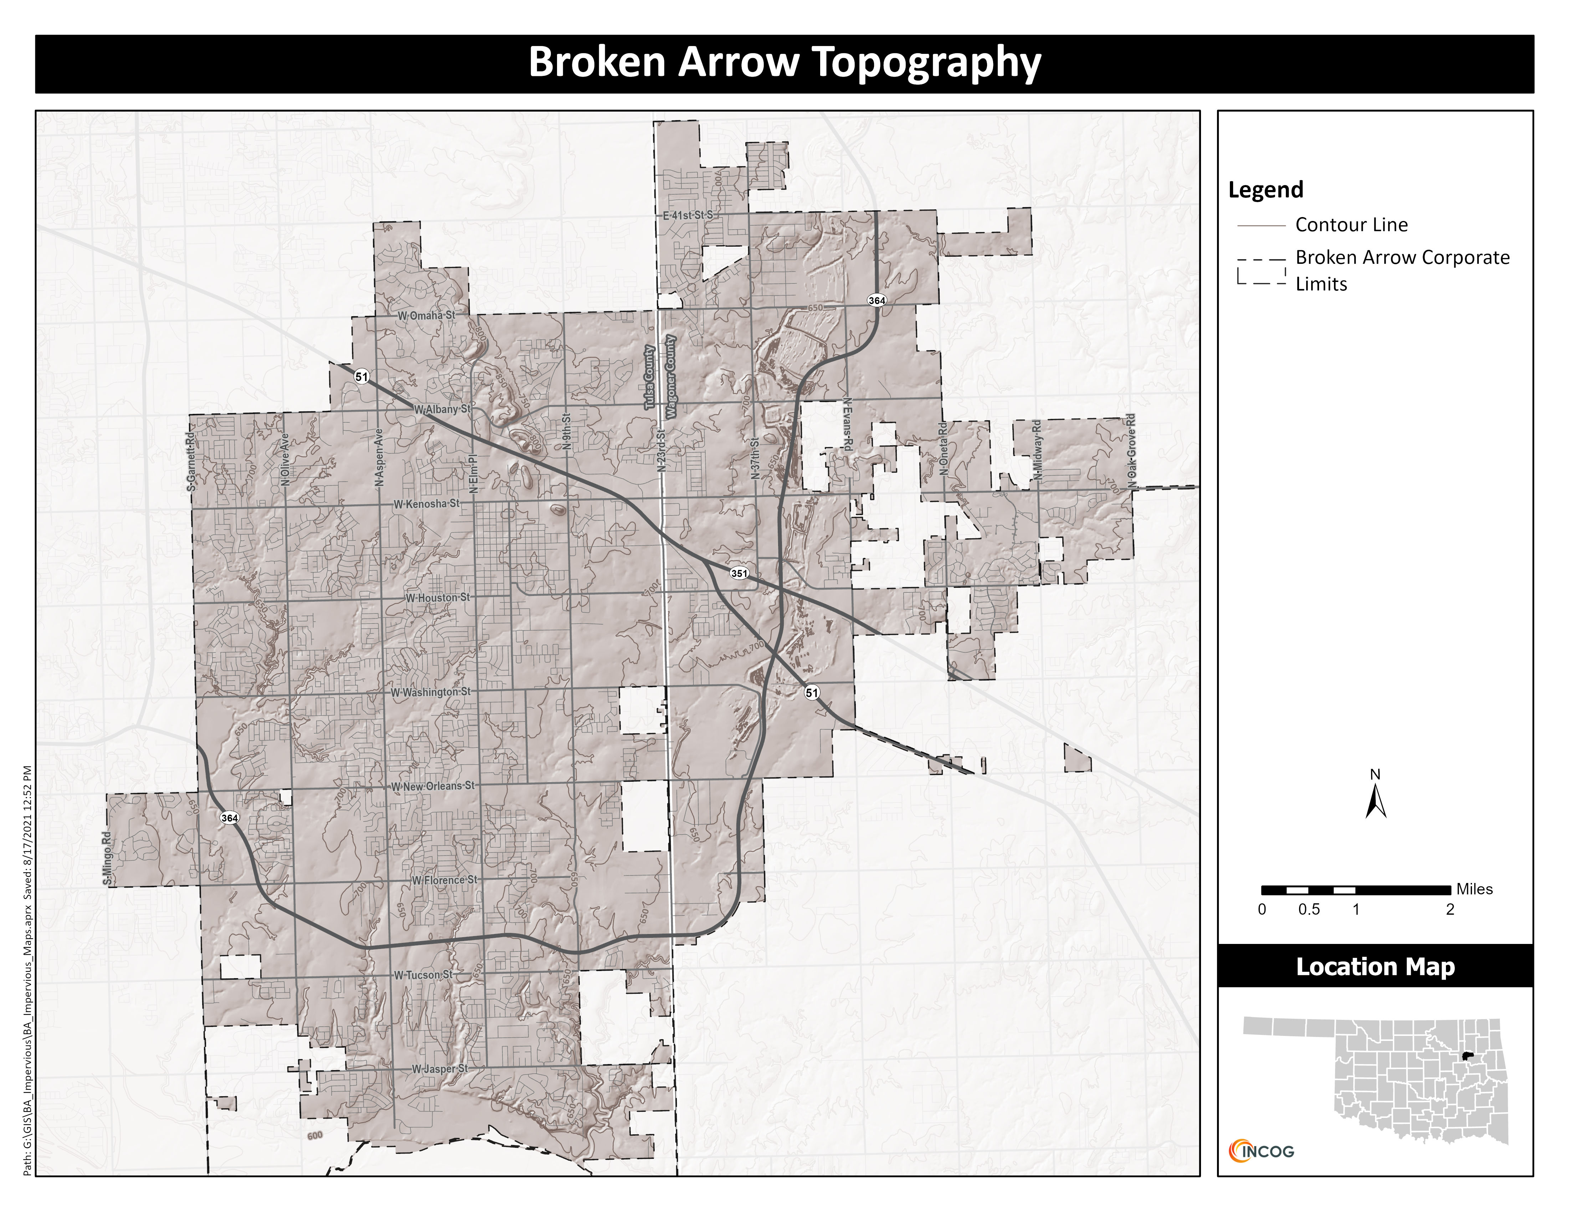

Slide 8
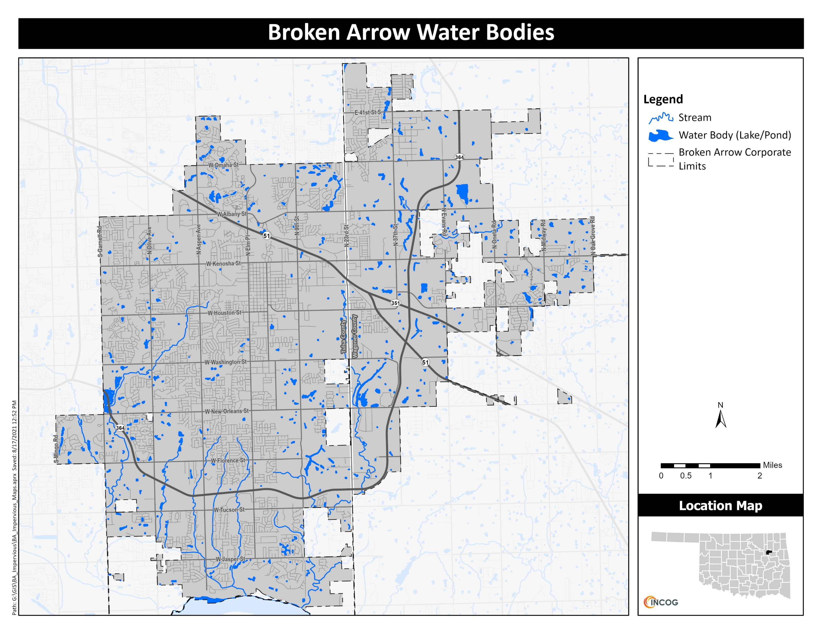

Slide 9
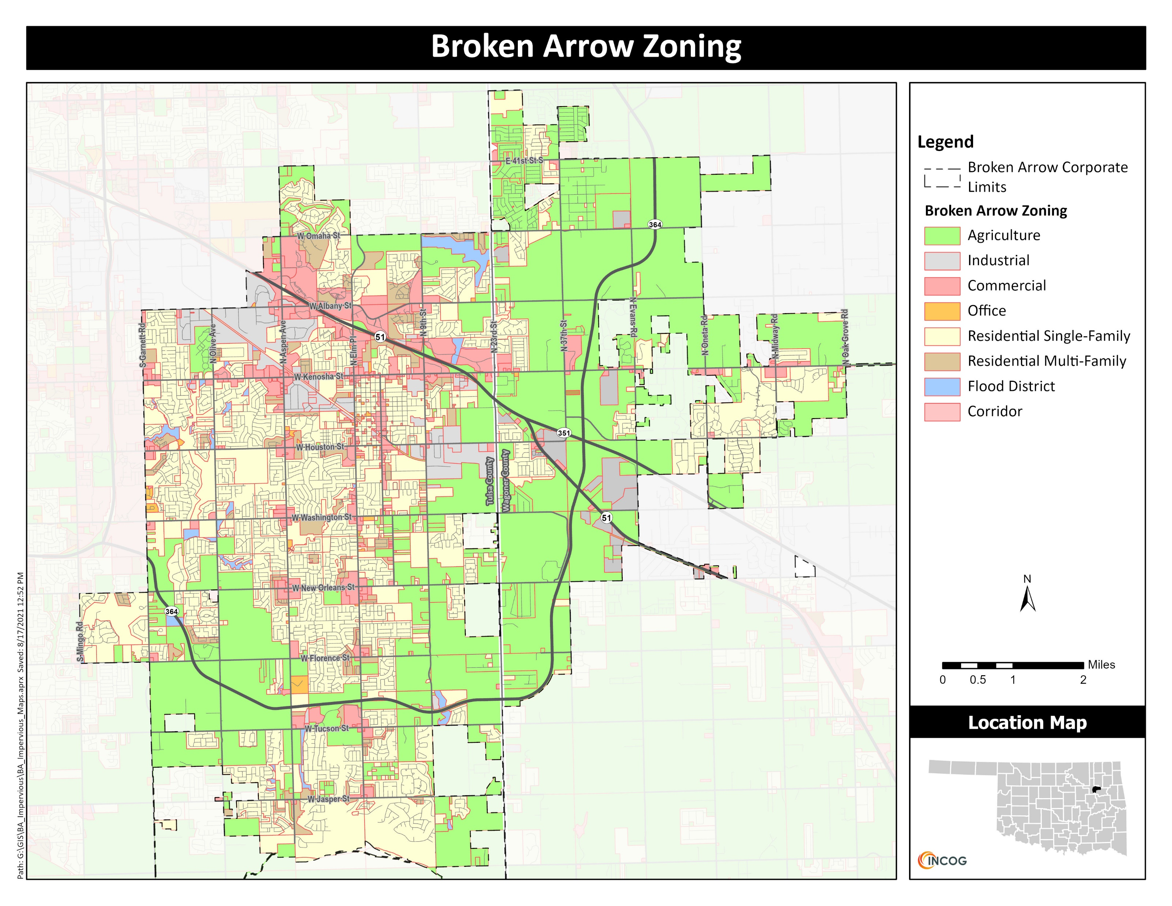

Slide 10
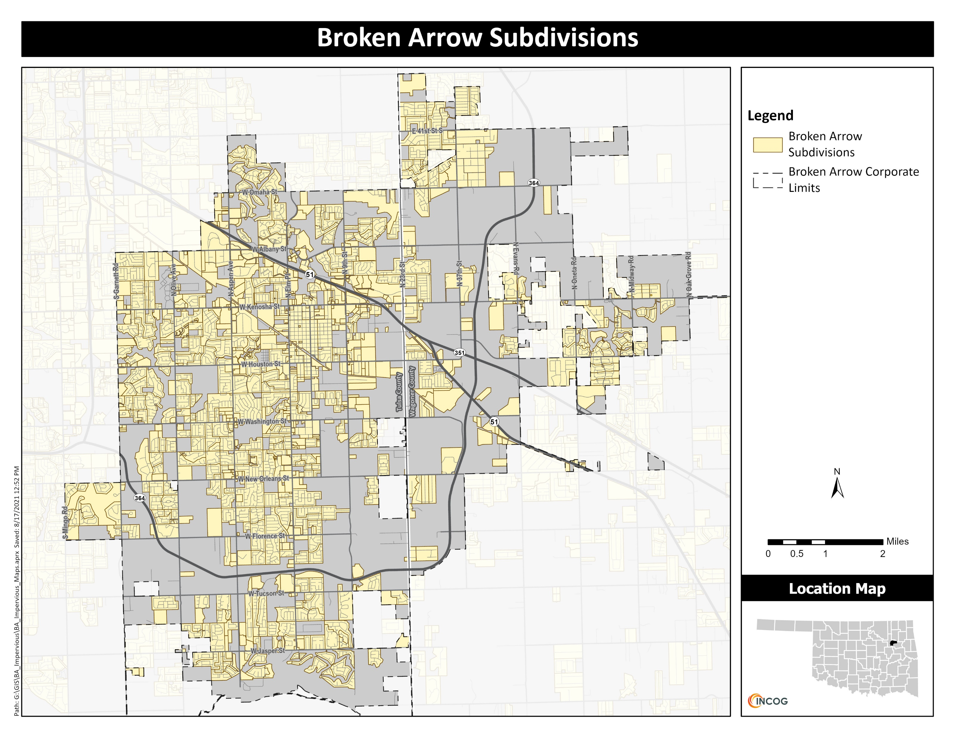

Slide 11
NAIP Aerials
NAIP aerials are published nationwide and taken during the growing season (leaf-on)
Often available in four bands
The first three bands contain red, green, and blue (RGB) values
These were used to calculate the mean values among the pixels inside each training sample
The fourth band is Near Infrared
There is also an option to display the imagery as false color to show the infrared (IR) band or to display the Normalized Difference Vegetation Index (NDVI)

Slide 12
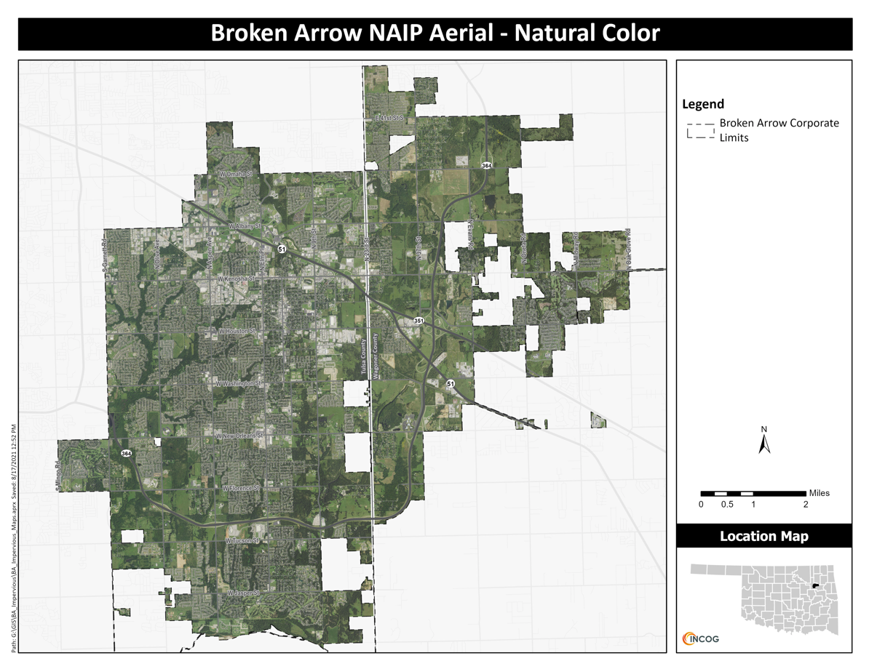

Slide 13
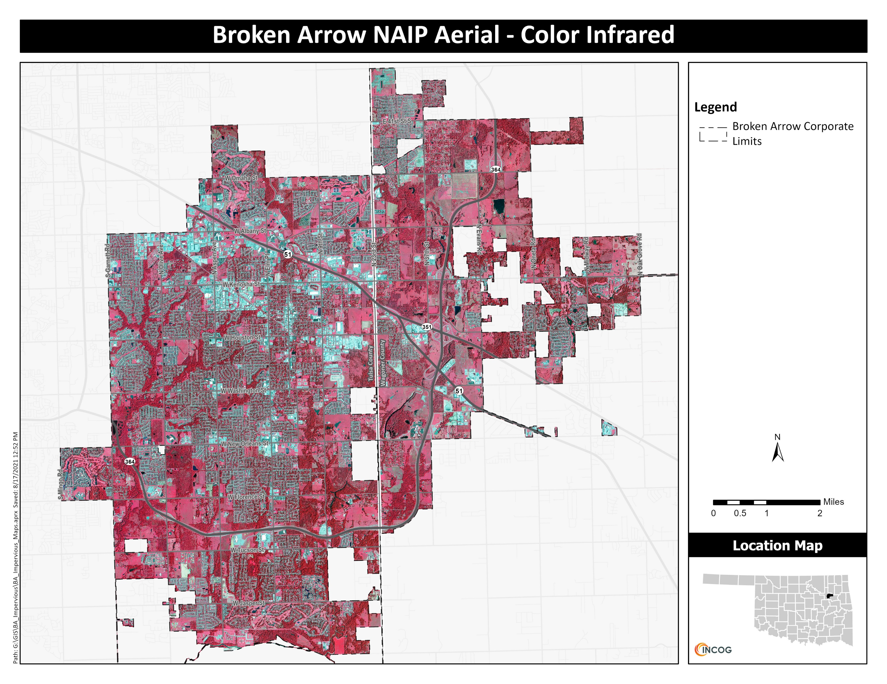

Slide 14
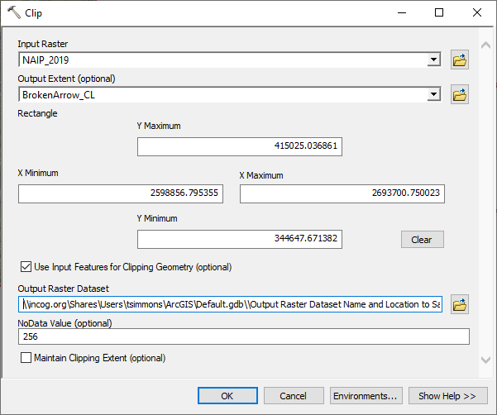
Getting Started
Open ArcGis Desktop and save a map document (.MXD file) in the working directory
Locate and save additional shapefiles and maps you will use
To reduce a map file size, use the clip raster tool (Toolboxes: Data Management Tools>Raster>Raster Processing>Clip)

Slide 15
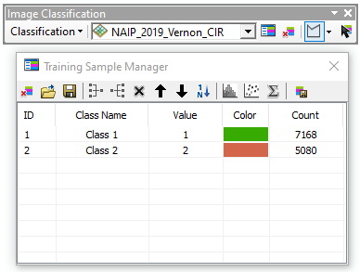
Image classification and Training Sample Manager
Activate Image Classification toolbar
Activate Training Sample Manager. This is used to draw polygons to identify classes and calculate their signatures. These identify homogenous land/cover uses (i.e., classes).
Classes can be merged and renamed to form a single class and colors can be changed to reflect the land cover that correlates to that class.

Slide 16
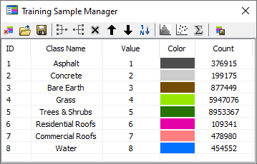
Image classification and Training Sample Manager
Initial classes identified were asphalt, concrete, bare earth, grass-maintained, grass un-maintained, trees & shrubs, residential roofs (asphalt shingles), commercial roofs, and water.
It was difficult to discern between grass-maintained and grass un-maintained, so they were merged into grass.

Slide 17


Evaluating Training samples
Training samples were compared to each other using the evaluation tools found in the Training Sample Manager, namely the Histogram, Scatterplot, and Statistics tools to determine whether there is enough separation between the classes.
Histogram showing distinction between spectral characteristics of water (blue) and commercial roofs (pink)
Histogram showing overlap between spectral characteristics of water (blue) and trees & shrubs (green)

Slide 18
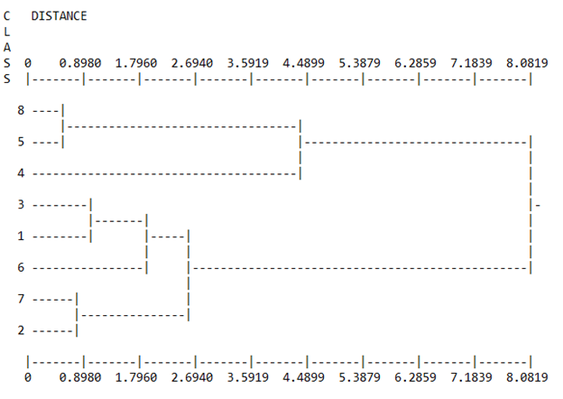
Signature files
When all training samples have been created and evaluated, a signature file can be created. The signature file is used by the Maximum Likelihood Classification tool to automatically assign each pixel in the NAIP aerial to one of the classes identified using the Training Sample Manager.
Before classification is executed, further evaluation of the signature file can be performed using the Dendrogram tool. This tree diagram shows the separation of the training sample classes.
Dendrogram showing classes with similar characteristics for the natural color aerial.

Slide 19
dendrogram Analysis
The dendrogram for this project revealed that the classes identified for water and trees & shrubs (Classes 8 & 5) shared many similarities, as did bare earth and asphalt (Classes 3 & 1), and commercial roofs and concrete (Classes 7 & 2).
Using a GIS waterbody feature map to identify water instead of relying on image classification would solve the overlap issue for water and trees & shrubs, enabling those classes to be merged. Water, trees, and shrubs represent land areas that are pervious.
Merging commercial roofs with concrete would resolve the overlap present with those two classes since they are both impervious.
Bare earth and asphalt present a problem as those two classes fall within pervious and impervious, respectively.

Slide 20
Classified Raster
Once the signature file has been evaluated and any necessary edits have been made, the Maximum Likelihood Classification tool can be executed to create a classified raster.
The Maximum Likelihood Classification tool assigns each pixel in the NAIP aerial to one of the training sample classes identified using the Training Sample Manager.
Examining the resulting classified raster may reveal areas that were misclassified by the tool.
These can be cleaned up using some post-processing tools, such as filtering, smoothing, or removing small, isolated regions.

Slide 21
Observations Regarding maps on next slide
Initially, the analysis was run with the natural color NAIP aerial and later with the infrared NAIP aerial using all 8 land cover classes.
Different land cover types are distinguishable from each other, but there were misclassifications.
Some parking lots along the lower part of the image were misclassified as residential roofs.
The areas surrounding streets were misclassified as bare earth, for the natural color aerial, and as commercial roof for the infrared aerial.
In the natural color aerial, water is shown to be prevalent among the trees, and for both aerials, shadows are being classified as water.
The roof of the building at the bottom of the image is mostly classified as commercial roof in the natural color aerial, but almost entirely as concrete in the infrared aerial.

Slide 22
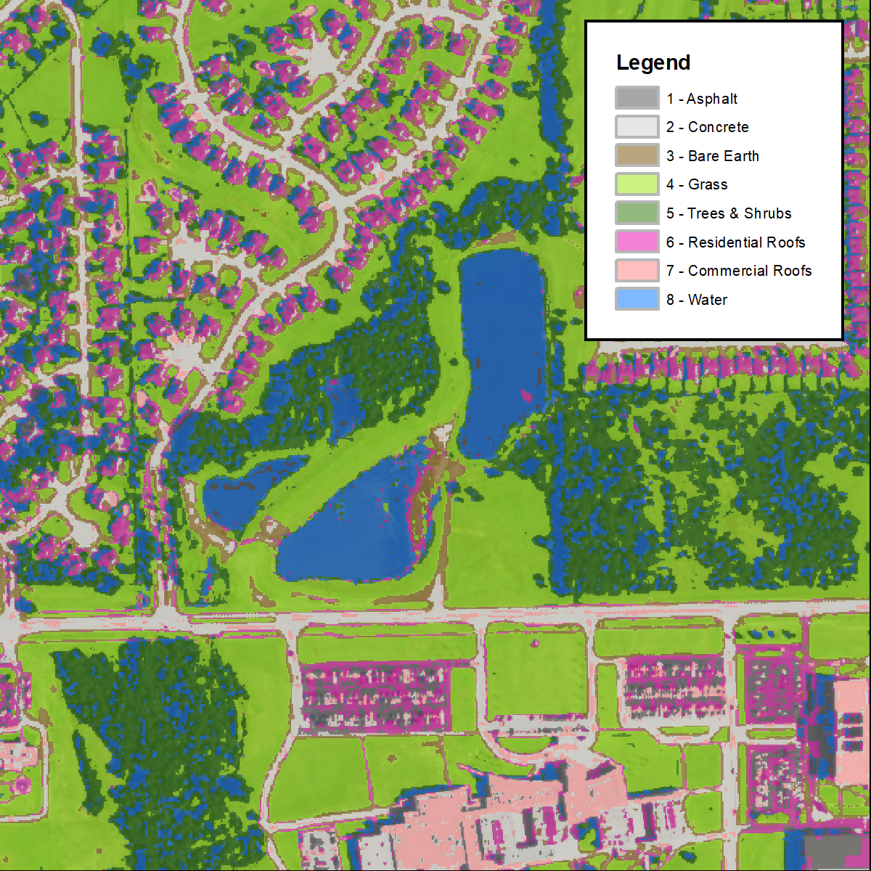
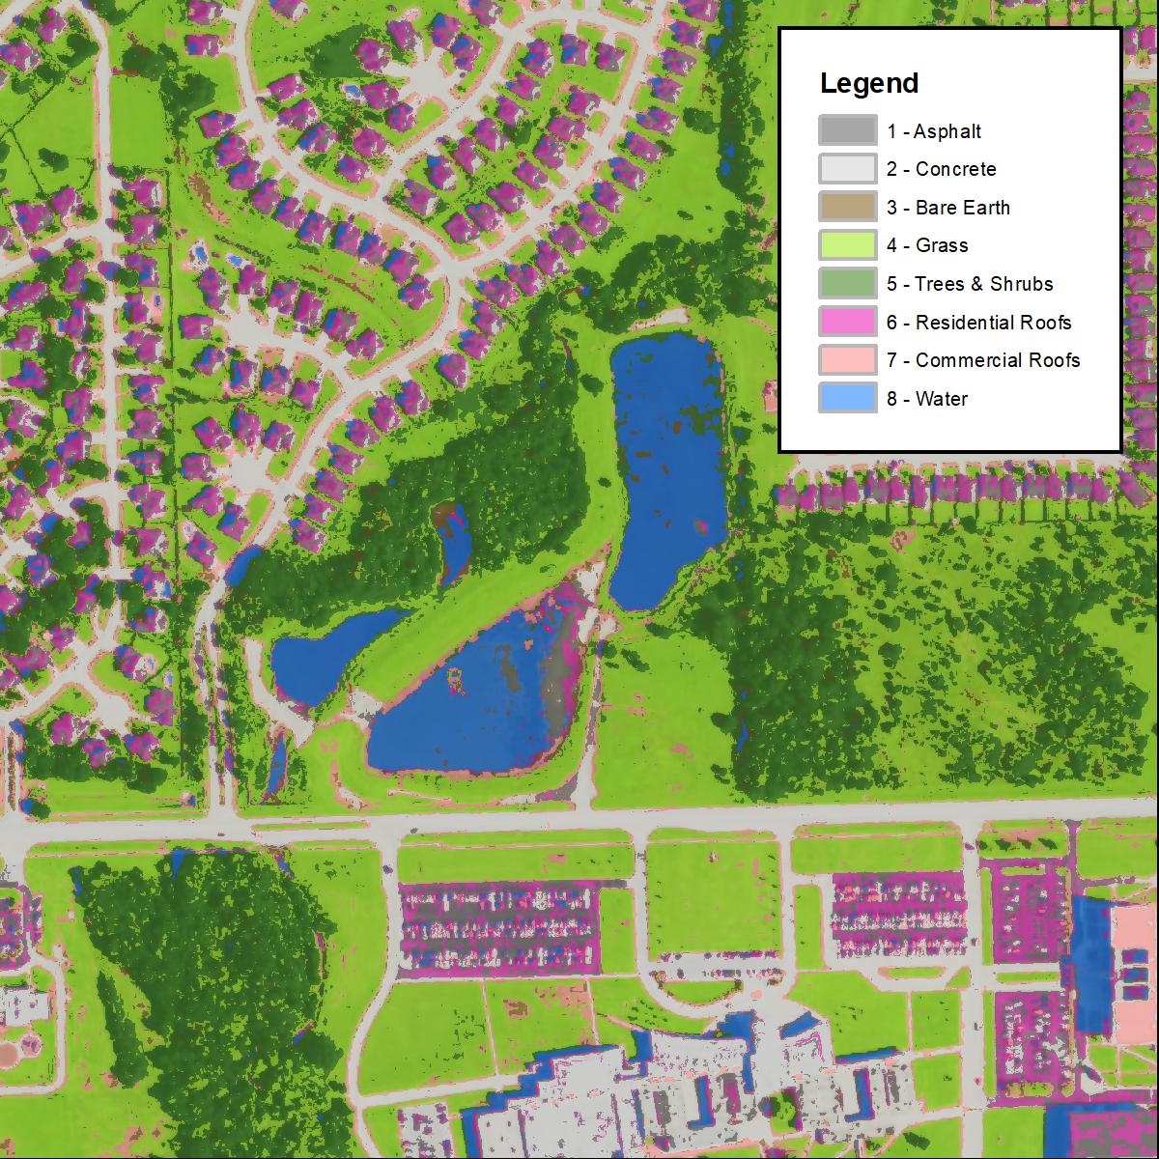
Classified raster using the natural color NAIP
Classified raster using the infrared NAIP

Slide 23
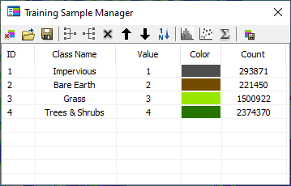
Misclassification Adjustments
Due to the misclassifications of the first run, a new training sample was created from the original to improve the classifications.
Classes 8 and 5 (water and trees & shrubs) were merged since their spectral characteristics were so similar and a GIS waterbody feature was available.
It was also decided to disregard the distinction between the various types of impervious surfaces and merge them all into one impervious category.
Classes 1 (asphalt), 2 (concrete), 6 (residential roofs), and 7 (commercial roofs) were merged to form a single impervious class.
Training Sample Manager with 4 classes

Slide 24
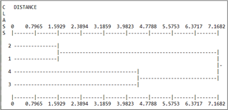
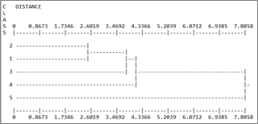
Misclassification Adjustments
The dendrogram tree diagrams for each of the signature files created from the new merged classes reveals that classes 1 and 2 (impervious and bare earth) have similar spectral characteristics, particularly for the natural color aerial. However, those two classes represent impervious and pervious land covers, so they were not merged.
The Maximum Likelihood Classification tool was then run again using the two new signature files created from the merged training samples. The results are shown on the next slide.
Dendrogram showing merged classes with similar characteristics for the natural color aerial
Dendrogram showing merged classes with similar characteristics for the infrared aerial

Slide 25
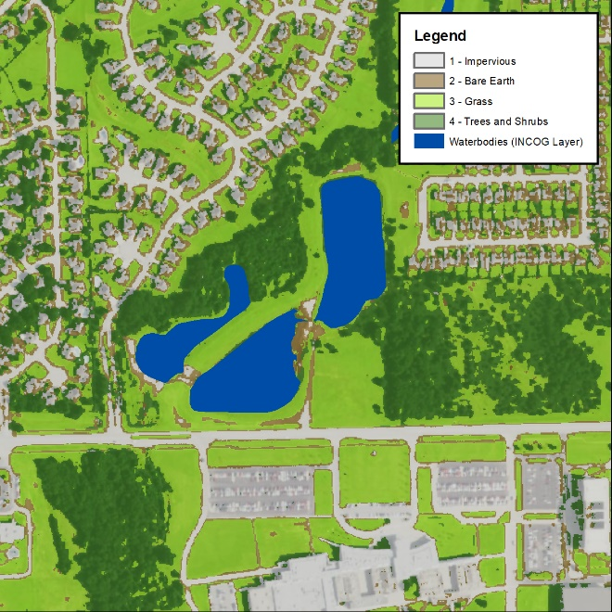
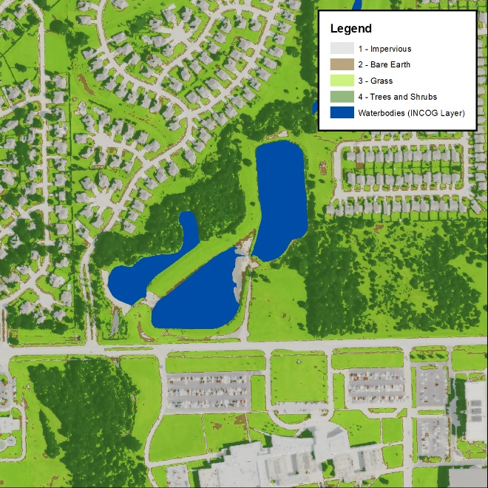
The analysis is now classifying impervious surfaces around the edge of streets and along roof lines as bare earth for the natural color aerial. The same is true for the infrared aerial, at least around the edges of streets.
Grass and trees & shrubs appear to have been classified well for both aerials. Unfortunately, the analysis is classifying many building shadows as trees.
Natural color
Infrared

Slide 26
Review at this point
Overall, the analysis using the infrared aerial appears to do a better job at distinguishing impervious from pervious surfaces.
However, bare earth presented a problem both with the natural color aerial and with the infrared aerial.
To improve upon it, some post-classification processing was employed, namely the majority filter and boundary clean tools were used to further refine the images.
Although subtle, the post processing improved the classification by removing isolated pixels and smoothing the edges.

Slide 27

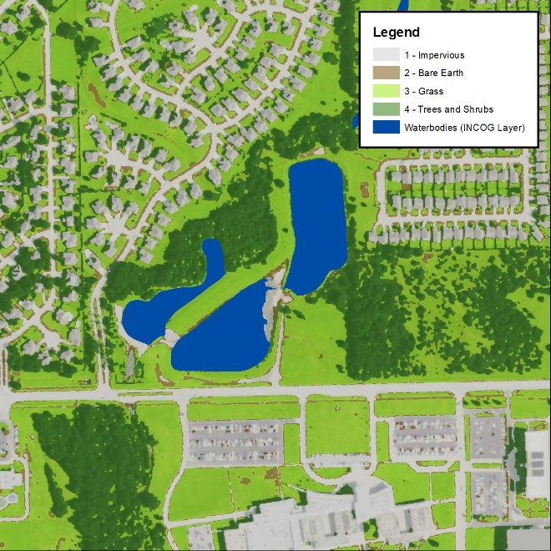
The figures below show the results of the post-classification processing.

Slide 28
Convert Classified Raster to vector
To perform any area calculations, such as acres of impervious surface per land cover class, it is necessary to convert the post-processed classified raster to a vector.
This is accomplished by using the Raster to Polygon tool found in the From Raster toolset located in the Conversion toolbox.
Once the land cover is in a vector format (polygon), it can be analyzed further by splitting it up based on any level of geography, such as watershed, and calculating area totals, such as acres, for the different land cover classes within the geography.
This is also the point at which building footprints and waterbodies could be inserted to represent those land covers more accurately and to arrive at better area calculations.

Slide 29
Lessons Learned
Certain land cover/uses are hard to distinguish from one another both at the human level (i.e., visually from aerials) and for the computer in terms of spectral characteristics.
In terms of visual characteristics, asphalt varied in color from light grey on old, weathered surfaces to dark grey or black for new surfaces.
Grass varied in color from light green to dark green depending upon soil moisture level, nutrient availability, grass height, and age.
Trees and shrubs were generally dark green.
Another limitation to using the NAIP aerial is the fact that tree canopy can obscure features, such as roadways and rooftops, resulting in areas being misclassified as pervious when in fact they are impervious.

Slide 30
Lessons Learned
Residential roofs (asphalt shingles) varied in color from light grey (almost white) to various shades of brown.
Commercial roofs were generally light grey to nearly white.
Metal roofs showed the most variation. They are available in almost any color of paint.
Water varied from light green to dark green and almost looked black at times.
In addition to the range of colors, the appearance of a surface can vary according to the angle of the sun, light intensity, cloud cover, and level of shade.

Slide 31
Original intent of the study
The original intent of this study was to explore the practicality of using NAIP aerial imagery to determine the imperious surface area of a large area of land.
Along the way we explored the possibility of looking at subclasses of pervious and impervious surfaces.
By combining all of the impervious surface area classes into a single class and all of the pervious areas into another class, we can produce a map showing pervious verses impervious surfaces with just two classes.
Once we have differentiated between pervious and impervious surface areas, we can begin to analyze this on a basin level.

Slide 32
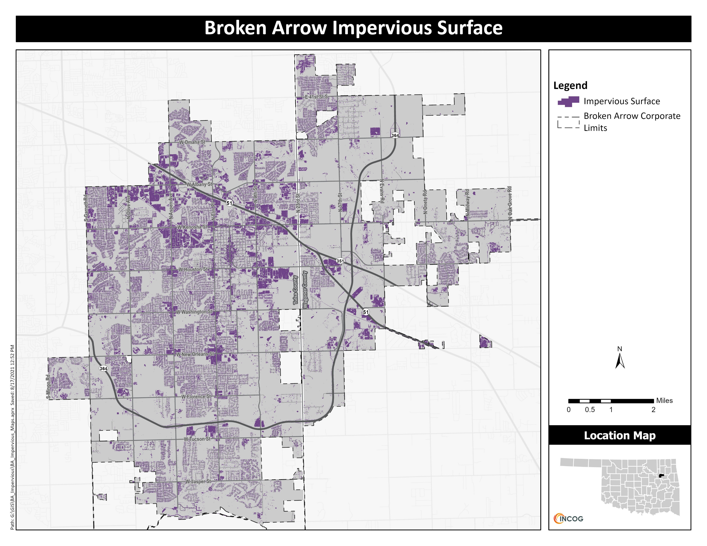

Slide 33
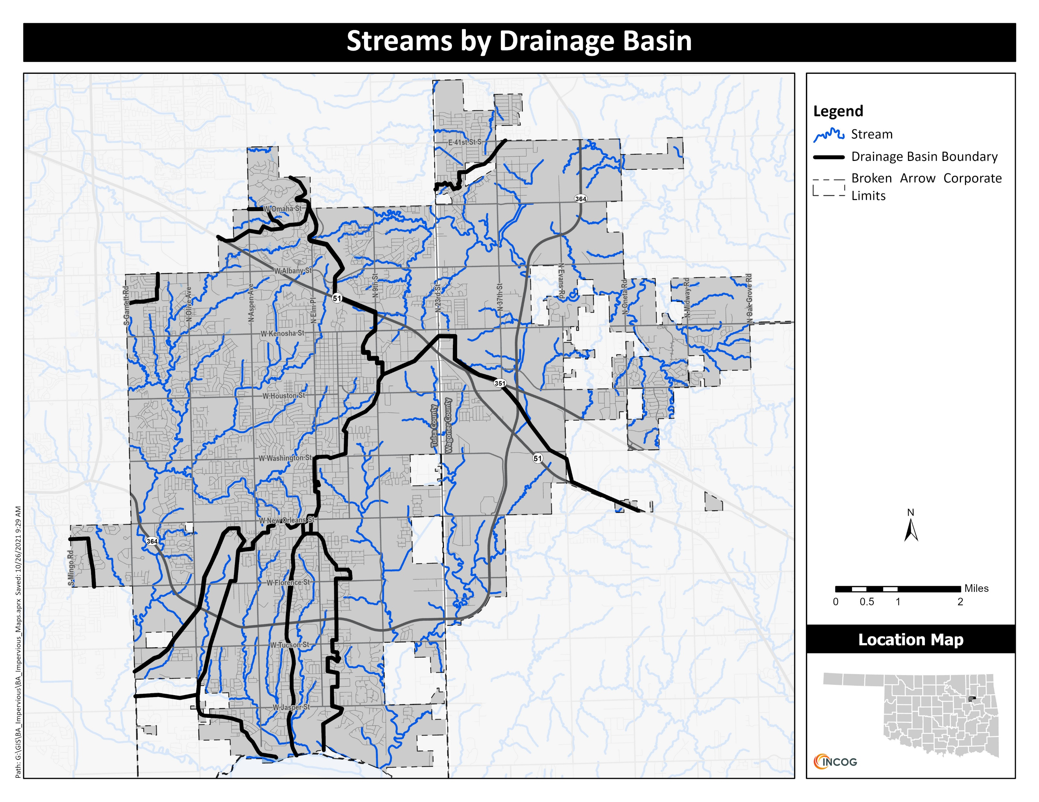

Slide 34
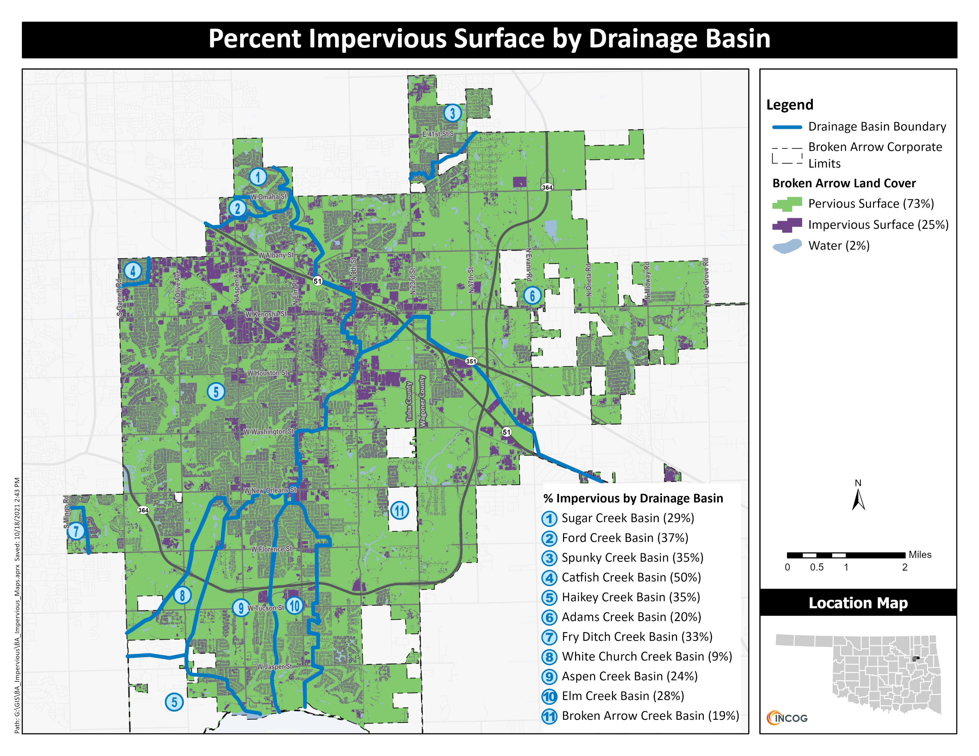

Slide 35
Using naip aerials to assess tree canopy
To perform a tree canopy assessment, a similar process to the one described for impervious surface area is employed.
Once the tree canopy for the municipality has been determined the search for canopy expansion areas can be conducted.
For this study, places identified as potential planting sites focused on land owned by the City of Broken Arrow. These areas can be protected from large scale development for years, giving the trees maximum opportunity to mature.
Local knowledge will rule out areas that are intended to be sports fields, where shelters or park buildings are planned, or where roadways and parking lots might be needed.

Slide 36
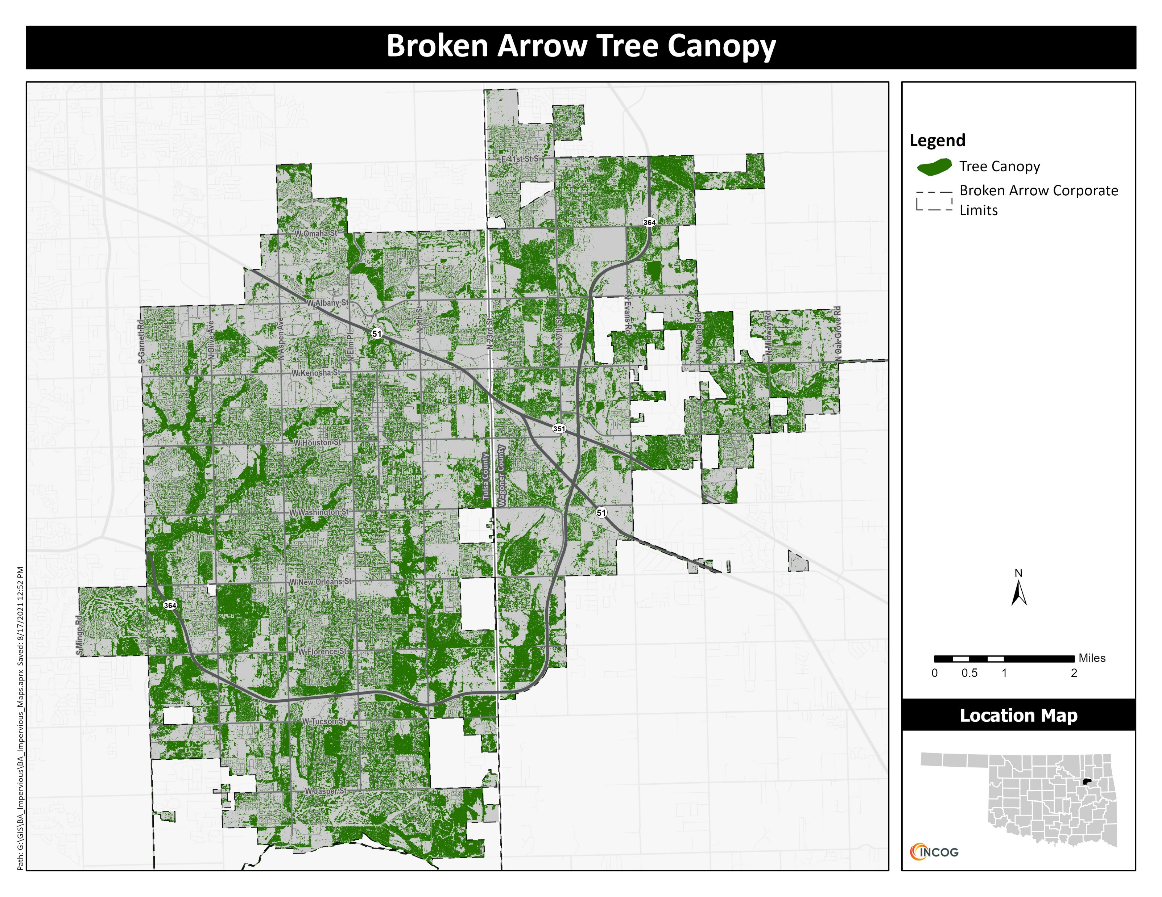

Slide 37
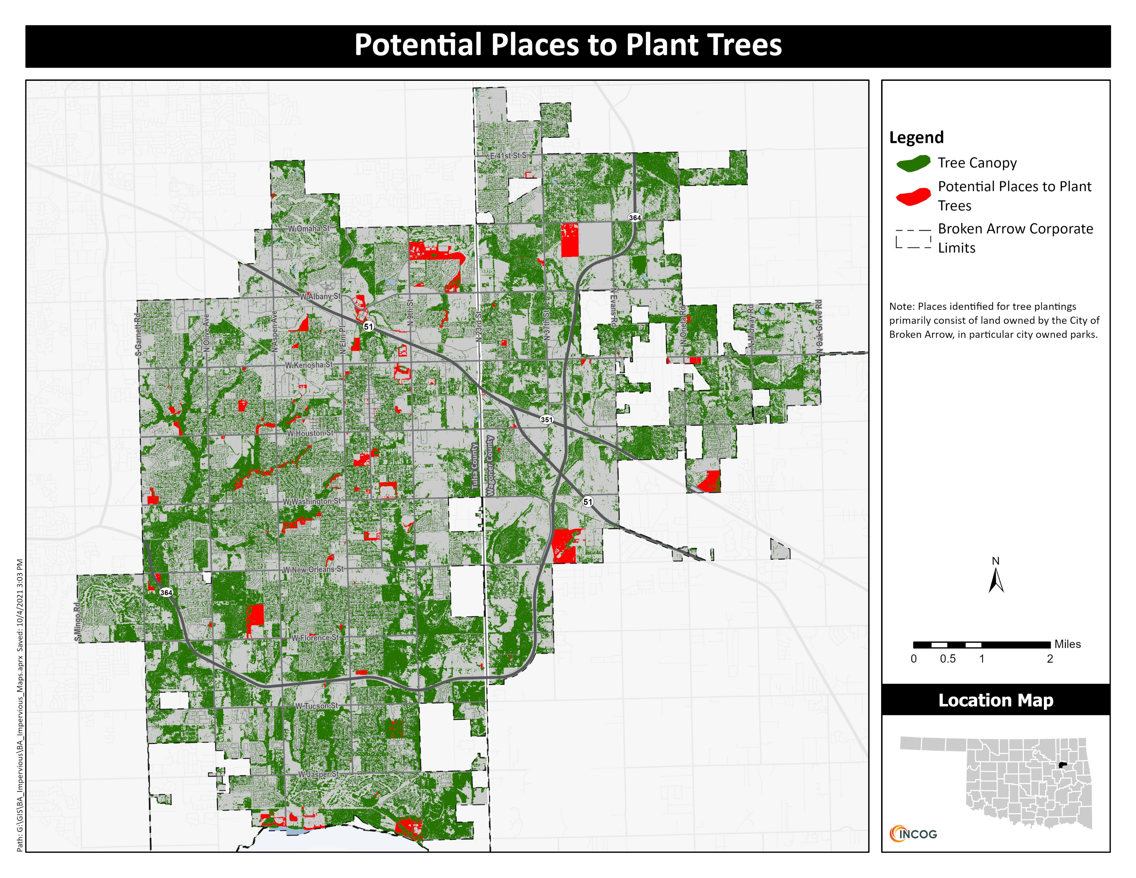

Slide 38
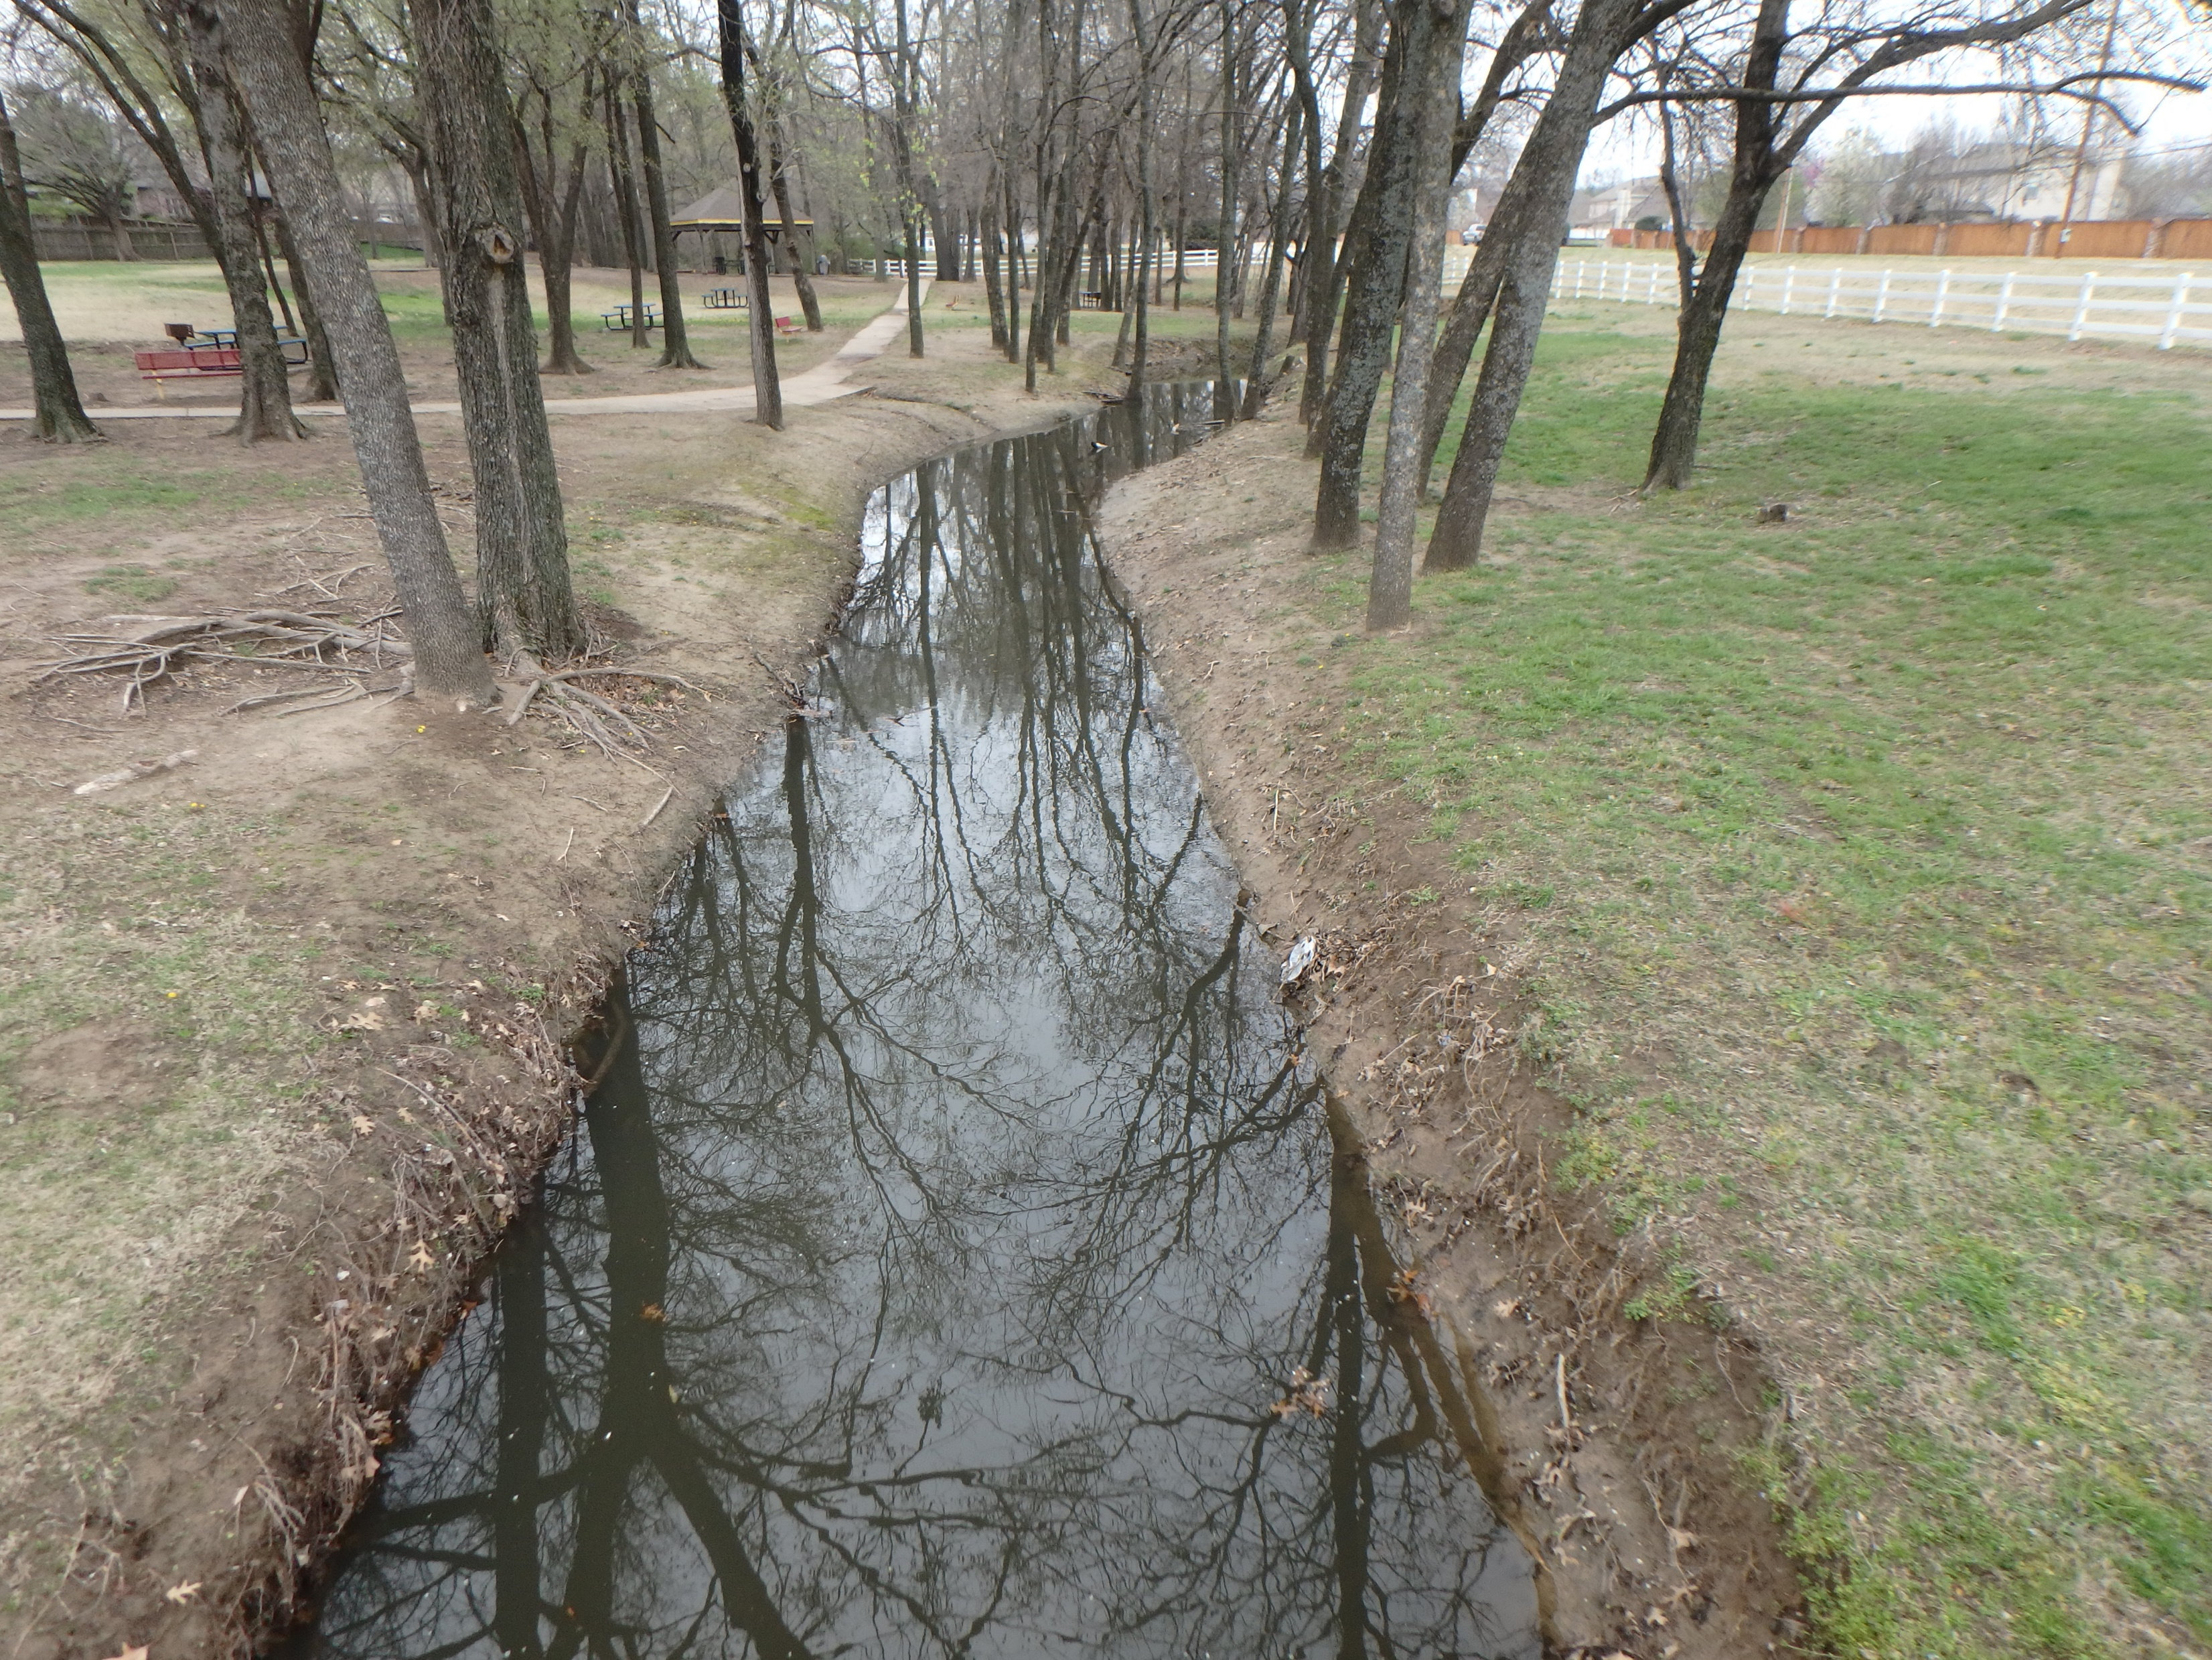
Thank You for Attending
For additional information, review the final project report and/or contact:
Ty Simmons or Vernon Seaman at INCOG.
Olive Creek

